Slide 1
K-means Clustering
Lecturer: TS Lê Văn Vinh
Student: 17110157 - Trần Ngọc Hùng
17110240 - Châu Huỳnh Phước Toàn

Slide 2
Content
Introduction, Presentation goals
Motivation and example
Clustering
K-means clustering algorithm definition, functions, iteration process, pseudocode
Computational complexity
Extensions
Tools
Application examples
References

Slide 3
» Introduction, Presentation goals
» Motivation and example
» Clustering
I

Slide 4
What you should be able to do after this Presentation?
Understand the concept of clustering, and particularly K-means clustering
Explain the K-means clustering algorithm
Provide diverse usage examples of the K-means clustering algorithm
Understand different challenges in the use of the K-means clustering algorithm and its extensions/variations

Slide 5
What is clustering
1

Slide 6
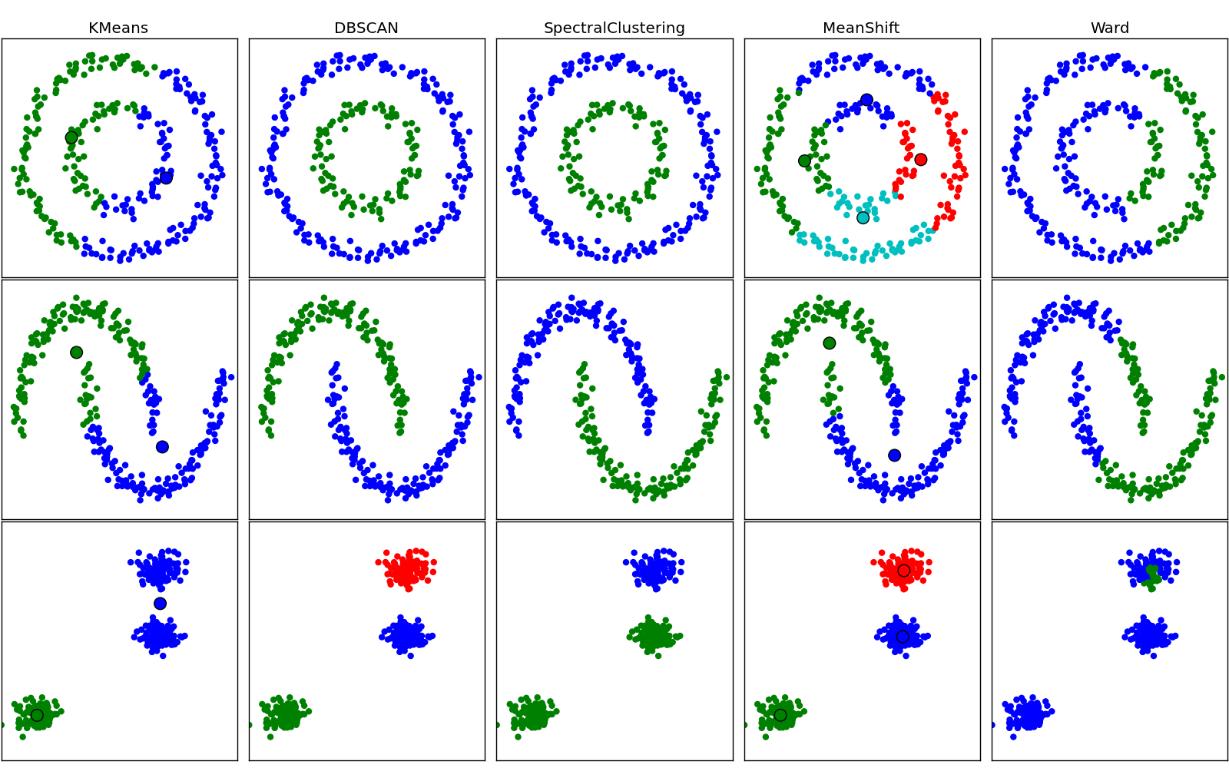
» Finding “natural” groupings between objects
» We want to find similar objects (f.e. documents) to treat them in the same way

Slide 7
Example
2

Slide 8
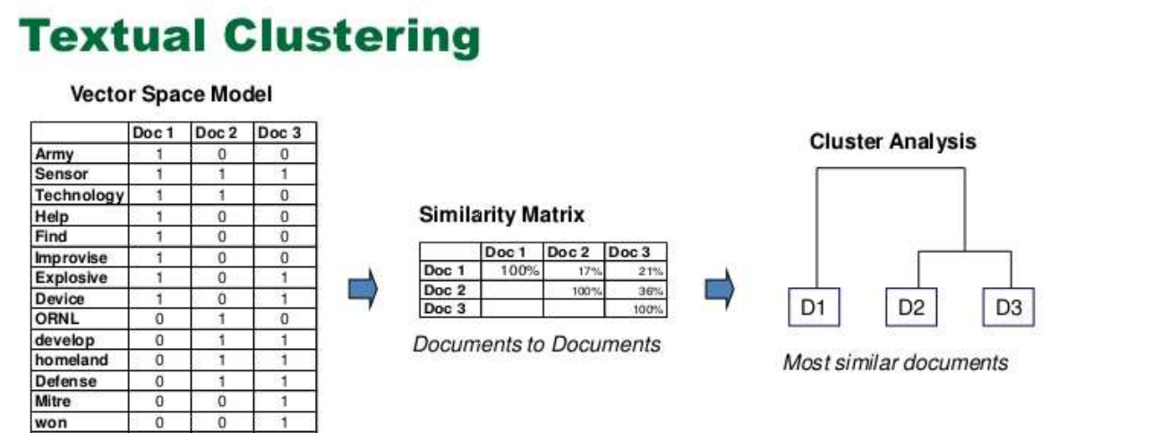
A web search engine often returns thousands of pages in response to a broad query, making it difficult for users to browse or to identify relevant information.
Clustering methods can be used to automatically group the retrieved documents into a list of meaningful categories.

Slide 9
Is clustering typically Unsupervised ?
3

Slide 10
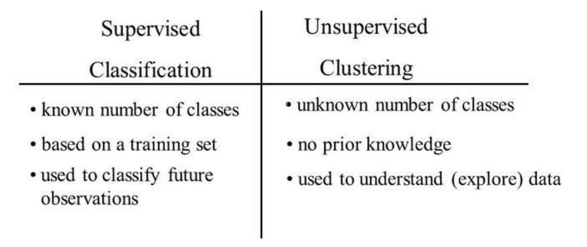

Slide 11
K-means clustering algorithm definition, functions, iteration process, pseudocode
II

Slide 12
What is K-means clustering?
1

Slide 13
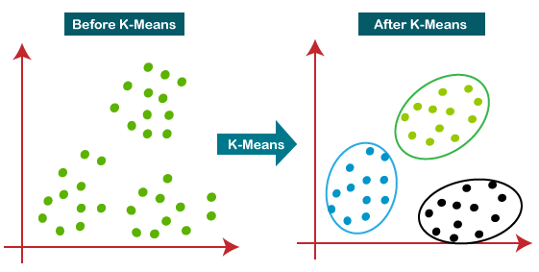
K-means clustering aims to partition n observations into k clusters in which each observation belongs to the cluster with the nearest mean

Slide 14
Examples of similarity measures
2

Slide 15
» Similarity is subjective
» Its measure therefore depends on the data, the use case, the users
» In practice it is not always straightforward which metrics work well - then “trial and error” can be followed
» Examples of similarity measures: Euclidean, Manhattan, cosine distance

Slide 16
How does K-means do the clustering?
2

Slide 17

K-means is a very important/basic flat clustering algorithm. Its objective is to minimize the average squared Euclidean distance of values from their cluster centers where a cluster center is defined as the mean or centroid u of the values in a cluster w :

Slide 18
Steps of
algorithm
3

Slide 19
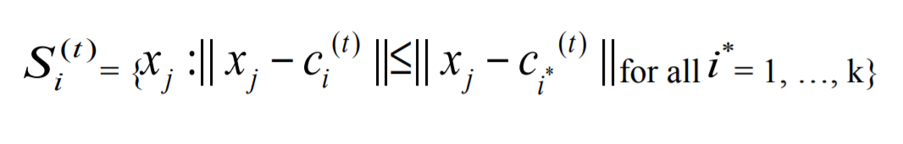
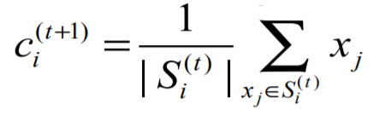
Step 1 : Initialization
Choose K as the focus {c1} (i=1÷k)
Step 2 : Distance calculation
Step 3 : Update focus position
Step 4 : Stop conditions
Repeat steps 2 and 3 until there is no change focus of the cluster

Slide 20
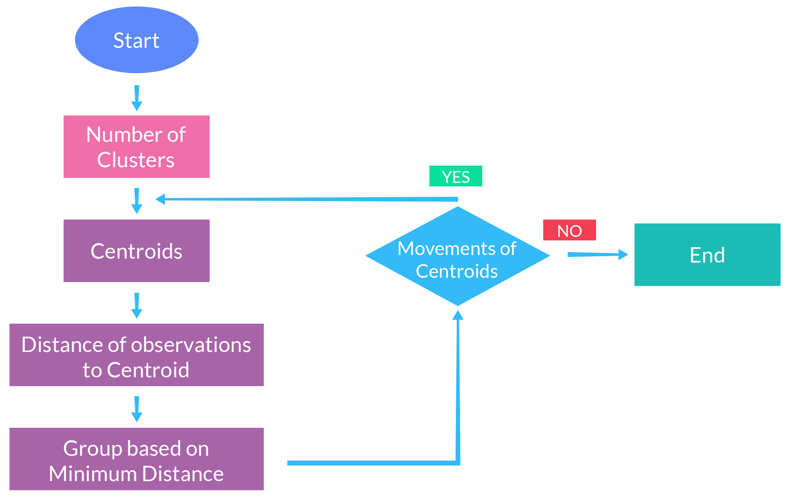

Slide 21
Example
4

Slide 22
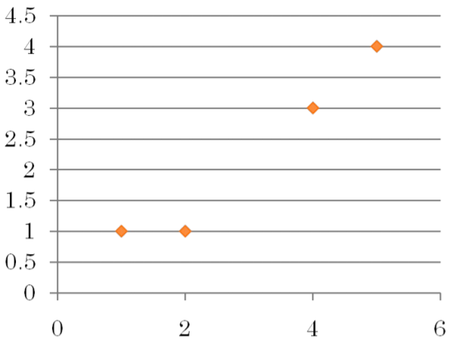
Object | Attribute 1 | Attribute 2
A | 1 | 1
B | 2 | 1
C | 4 | 3
D | 5 | 4

Slide 23
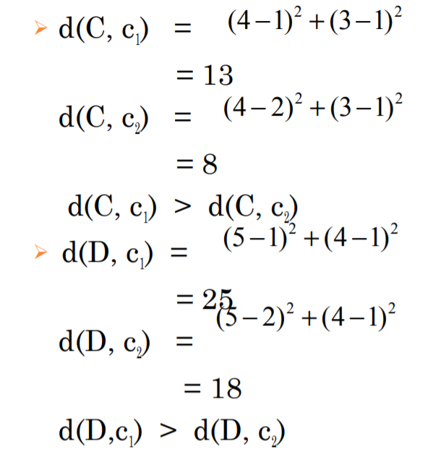
Step 1 : Initialization
Choose the first 2 center c1 (1,1) ≡ A và c2 (2,1) ≡ B
Step 2 : Distance calculation

Slide 24
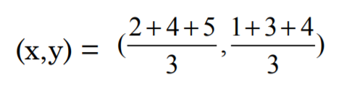
Step 3 : Update focus position
Update focus position 1 c1 ≡ A (1, 1)
Update focus position 2 c2
Step 4-1 : Repeat step 2, recalculate the distance
d(A, c1 ) = 0 < d(A, c2 ) = 9.89
d(A, c1 ) = 0 < d(A, c2 ) = 9.89
d(C, c1 ) = 13 > d(C, c2 ) = 0.22
d(D, c1 ) = 25 > d(D, c2 ) = 3.56
Step 4-2 :Repeat step 3, updating the focus
c1 = (3/2, 1) và c2 = (9/2, 7/2)

Slide 25
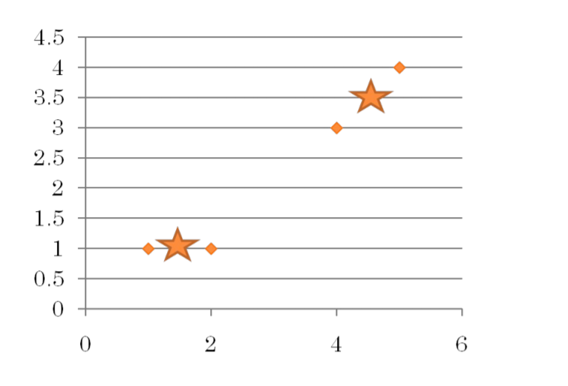

Slide 26
» Computational complexity
» Extensions
» Tools
II

Slide 27
Computational complexity
1

Slide 28
K-means computational aspects
» K-means converges, but there is unfortunately no guarantee that a global minimum in the objective function will be reached.
This is a particular problem if a document set contains many outliers , documents that are far from any other documents and therefore do not fit well into any cluster. We may end up with a singleton cluster (a cluster with only one document) even though there is probably a clustering with lower RSS.

Slide 29




What is the time complexity K-means?
» Most of the time is spent on computing vector distances. One such operation costs .
» The reassignment step computes KN distances, so its overall complexity is
.
» In the recomputation step, each vector gets added to a centroid once, so the complexity of this step is .
» For a fixed number of iterations I, the overall complexity is
therefore .

Slide 30
Extensions
2

Slide 31
There are numerous extensions to the K-means clustering f.e.
» K-means clustering can be generalized e.g. into a Gaussian mixture model.
» Efficiency problem can be addressed e.g. by K-medoids , a variant of K-means that computes medoids instead of centroids as cluster centers.
The medoid of a cluster as the value that is closest to the centroid. Distance computations are faster in this case.

Slide 32
Tool support
3

Slide 33
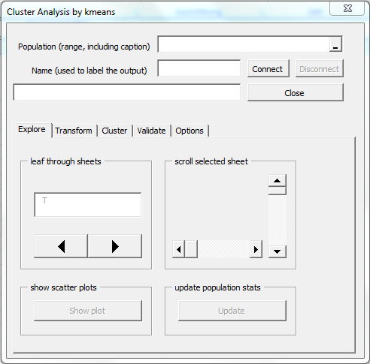
A number of tools implementing K-means clustering are available:
» Open source e.g. Apache Spark Torch, R, and
» Proprietary e.g. MATLAB, Mathematica, SAP HANA

Slide 34
» Application examples
» References
II

Slide 35
Application examples
1

Slide 36
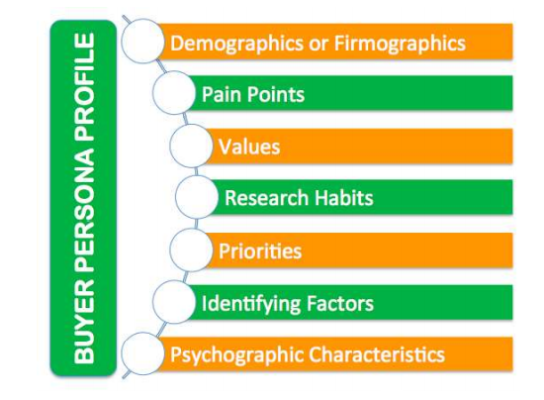
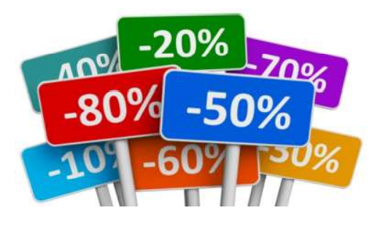
» User profiles/personas: similar purchase behavior…
» Product profiles: similar selling patterns
» Deciding when to discount product groups

Slide 37
References
2

Slide 38
» Hartigan, J. A., & Wong, M. A. (1979). Algorithm AS 136: A k-means clustering algorithm. Journal of the Royal Statistical Society. Series C (Applied Statistics), 28(1), 100-108.
» Manning С, R. P., & Schütze, H. (2008). Introduction to information retrieval. Cambridge University Press.
» K-Means Clustering at Wikipedia: https://en.wikipedia.org/wiki/Kmeans_clustering
» StatQuest: K-means clustering: https://www.youtube.com/watch?v=4b5d3muPQmA

Slide 39
THANKS!
Any questions?

